Slide 1

International Oil and Gas Outlook
NEMS/AEO Conference - March 27, 2001
Near-term Forecast Impacted by:
Slowing global economy
More drilling and project completions
Improving inventory and storage positions
Positive Longer-term Commodity Outlook
Oil and gas prices settle above historic norms
2001-2002 Price Outlook
Oil Price: $24.50 WTI in 2001, $21.50 in 2002
US Gas: $4.25 in 2001, $3.50 in 2002
Refining Margins: $3.07 in 2001, $2.47 in 2002
Adam Sieminski (410) 895-3347
adam.sieminski@db.com

Slide 2
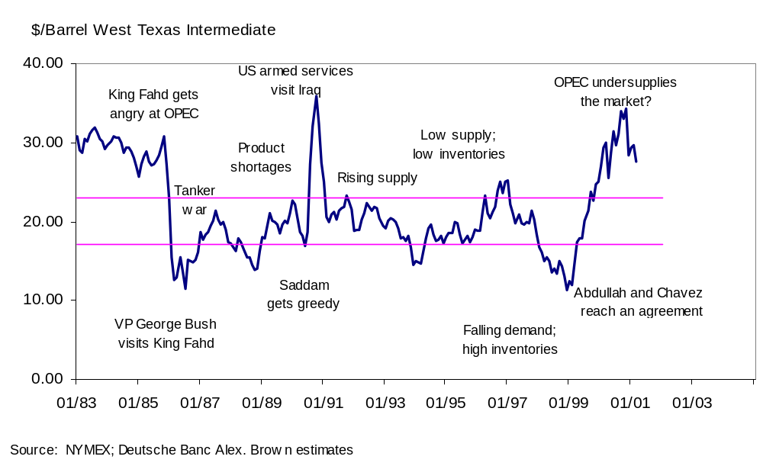
Oil Prices 1983-2001
...OPEC overshoots in 2000

Slide 3
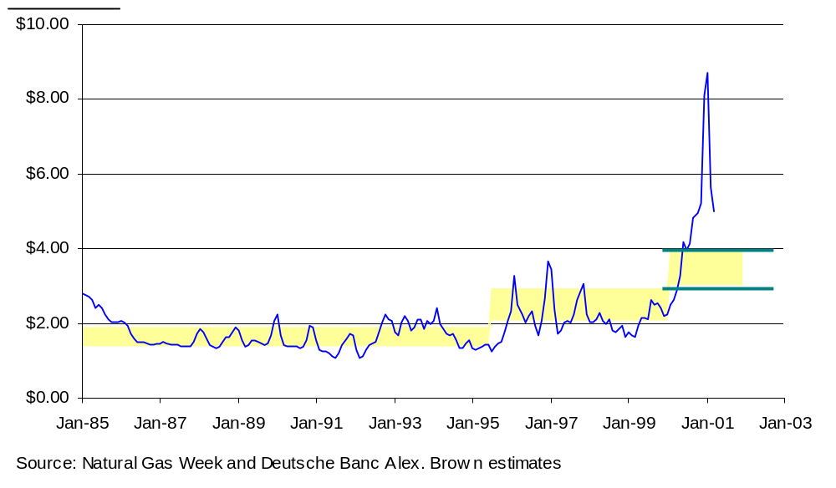
A New Trading Range for U.S. Natural Gas?
…wellhead through the roof in late 2000
Very high prices are not sustainable but prices are likely to settle much higher than average prices in the 1990s

Slide 4
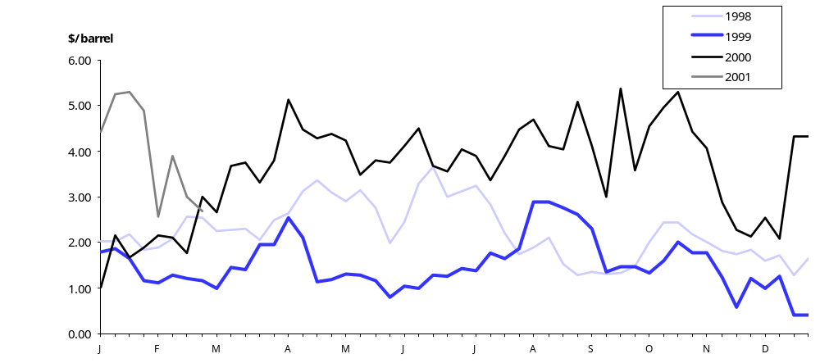
Average World Refining Margins
…outstanding 2000; lower -- but still strong -- 2001
Source: Petroleum Argus, Deutsche Bank

Slide 5
Oil Sector Snapshot
…our rationale for lower oil prices in 2001-2002 with long-term prices settling above historic averages
Global economic slowdown likely to shrink oil demand growth in 2001 …demand rises only 1.3 mmb/d with world GDP up about 3%
Non-OPEC supply up 1.2 mmb/d in 2001 ...prices and deepwater (Russia, Mexico, North Sea, Brazil and others)
Wellhead capacity utilization high now but production expanding ...OPEC cohesion likely to be tested in mid-2001
Low inventories fostered upward price volatility in 2000 ...forecast recovery to normal levels should help ease prices
One-time events could act as “spoilers” to the outlook …Iraq exports; Middle-East tensions; weather; U.S. policy shifts

Slide 6
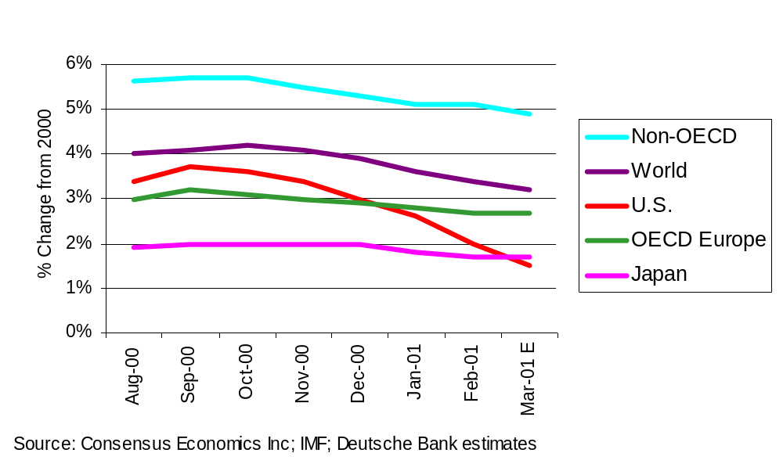
World GDP Forecasts for 2001 Are Falling
…slowdown in the U.S. threatens non-OECD Asia and presents a major downside risk to oil demand

Slide 7



Oil Demand and Real GDP from 1995-2000
…global yearly average was 3.8% real GDP and 1.8% oil
12%
8%
Mid-
Other
East
Asia
4%
Annual % Change in Oil
Lat Am
0%
-4%
Every 1% of world GDP growth = 0.4 mmb/d annual growth in oil use
FSU
-8%
-2%
0%
2%
4%
6%
8%
10%
Annual % Change in GDP
Source: IEA; IMF; Deutsche Bank estimates

Slide 8
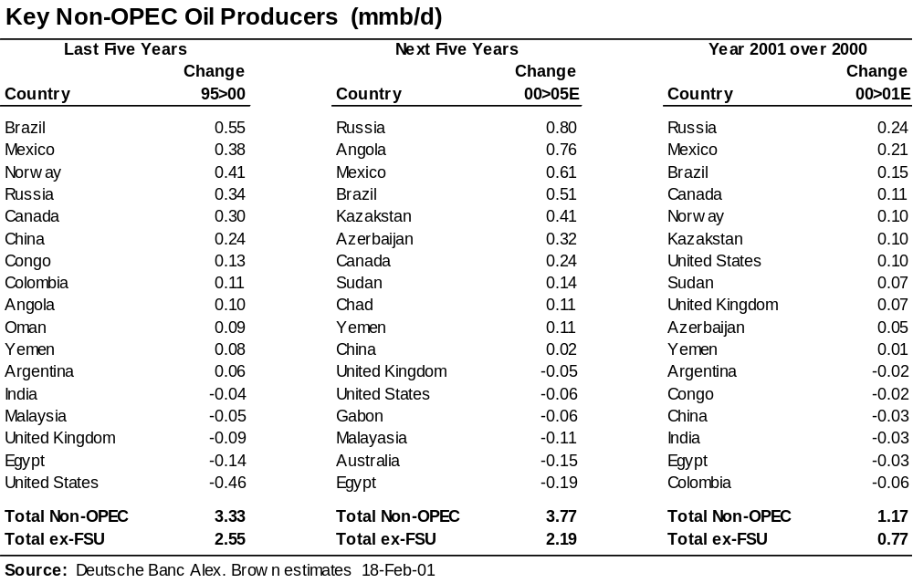
Non-OPEC Production Grows Strongly in 2000
…but political risk is rising in 2001-2005

Slide 9
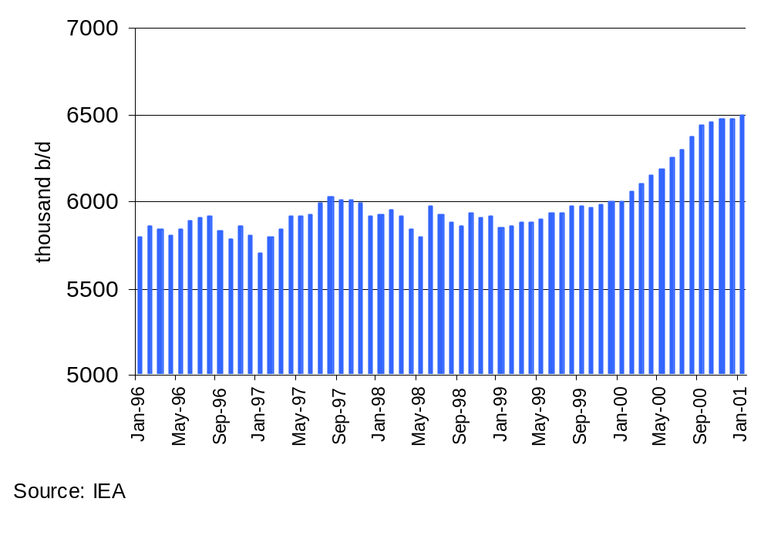
Russian Crude Oil Production
…the long winter appears to have ended in late 1999

Slide 10
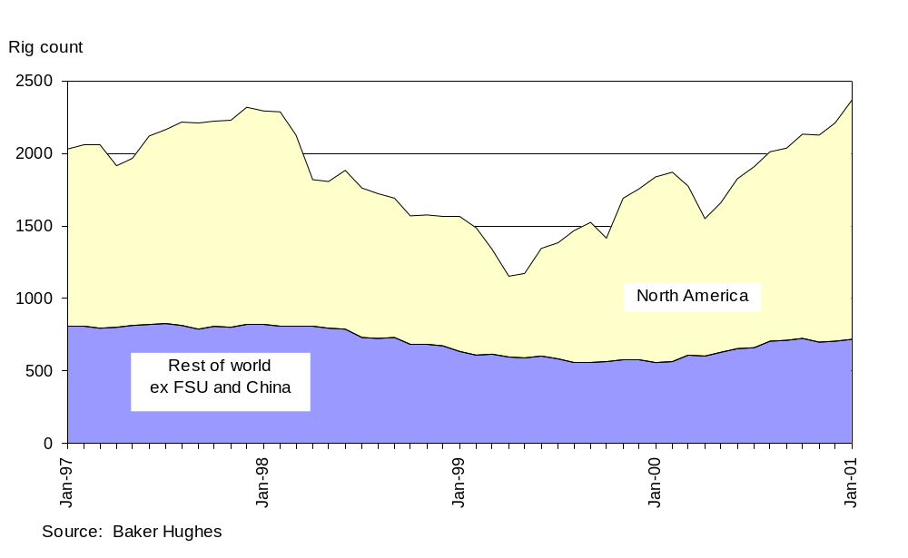
Rebound in Drilling Points to Future Rise in Supply
…active drilling rigs 1997-2001

Slide 11
Oil Prices: the OPEC Basket
…a bounce up from OPEC cuts and Iraq worries
$/bbl
35
30
25
20
15
$22-28/bbl range for the OPEC basket
10
5
0
Apr-98
Jul-98
Oct-98
Jan-99
Apr-99
Jul-99
Oct-99
Jan-00
Apr-00
Jul-00
Oct-00
Jan-01
Apr-01
Source: Bloomberg; PIW; Deutsche Banc Alex. Brown

Slide 12
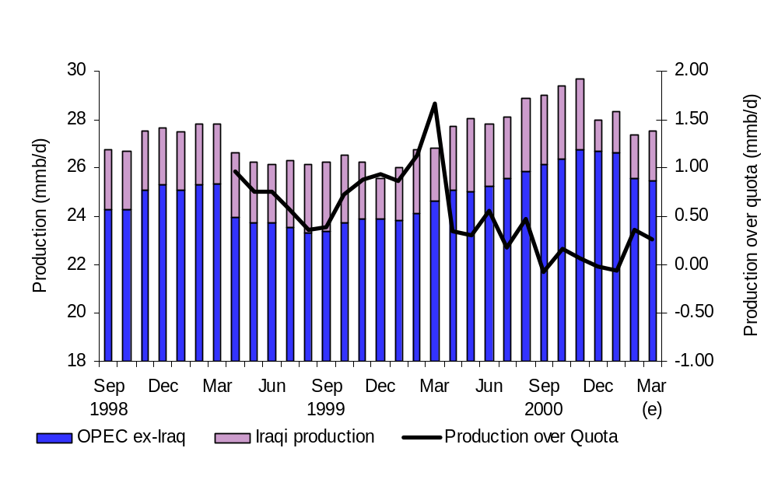
OPEC Production Rising and Falling
…quotas may have to be lowered again in 2Q 2001 and raised in 4Q 2001

Slide 13
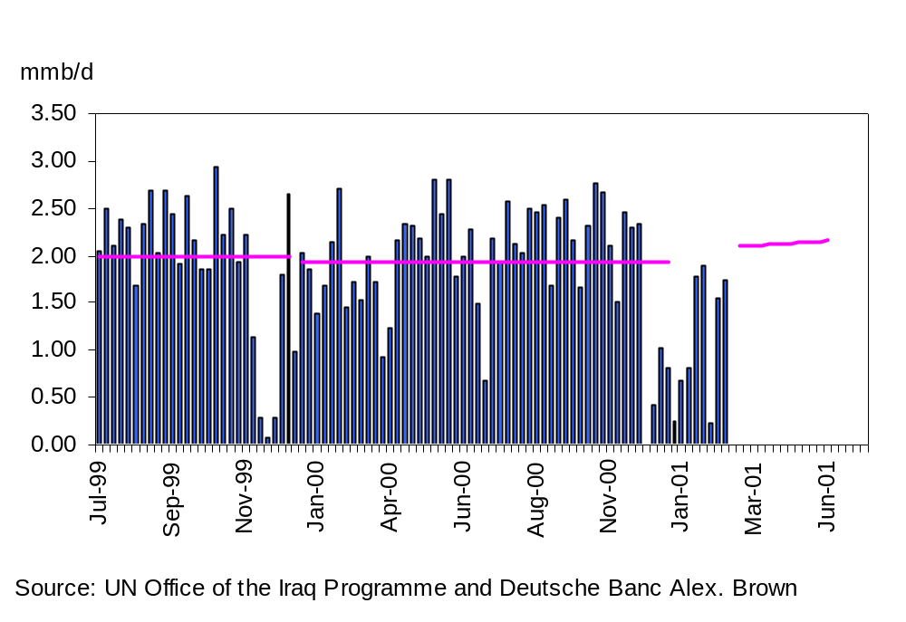
Iraq's Weekly Oil Exports
…high volatility related to disputes with the U.N. a major upside risk for the oil markets in 2001
Iraq's oil exports averaged about 2.0 mmb/d in 1999 and 1.9 mmb/d in 2000. We believe sustainable export capacity is over 2 mmb/d.
Exports may climb as spare parts arrive under the oil-for-food program

Slide 14
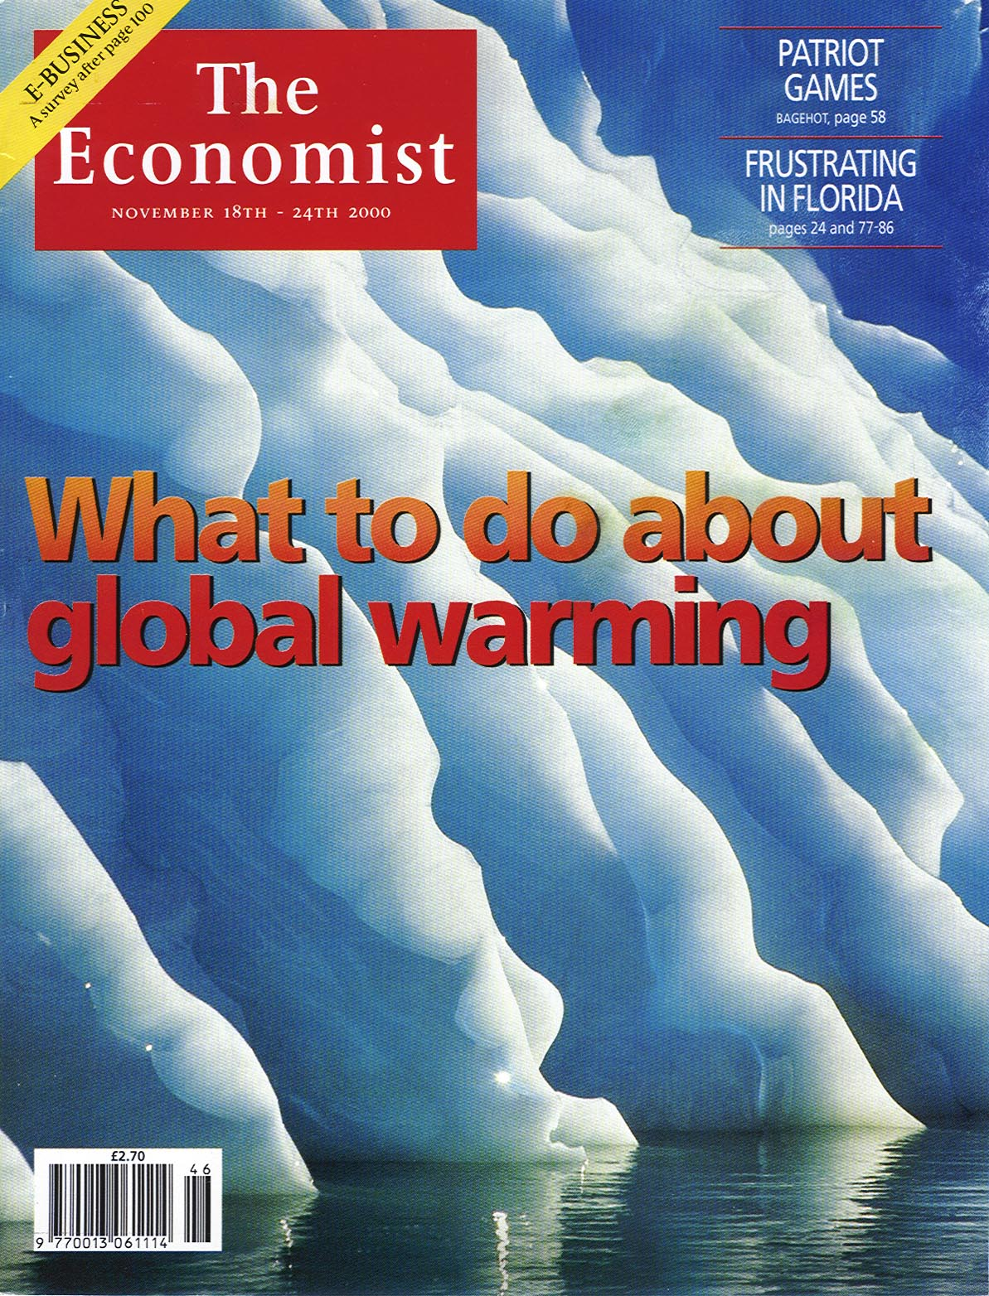
A Recent Warm Winter Trend?
…followed by a reversion to cold?
U.S. Heating
The Economist Magazine, November 18-24, 2000
Degree Days
(Oct-Mar)
4800
4600
4400
Cold
Winters
4200
4000
3800
3600
Warm
3400
Winters
3200
3000
1931/32
1936/37
1941/42
1946/47
1951/52
1956/57
1961/62
1966/67
1971/72
1976/77
1981/82
1986/87
1991/92
1996/97
2001/02
Source: NCDC, Deutsche Banc Alex. Brown

Slide 15
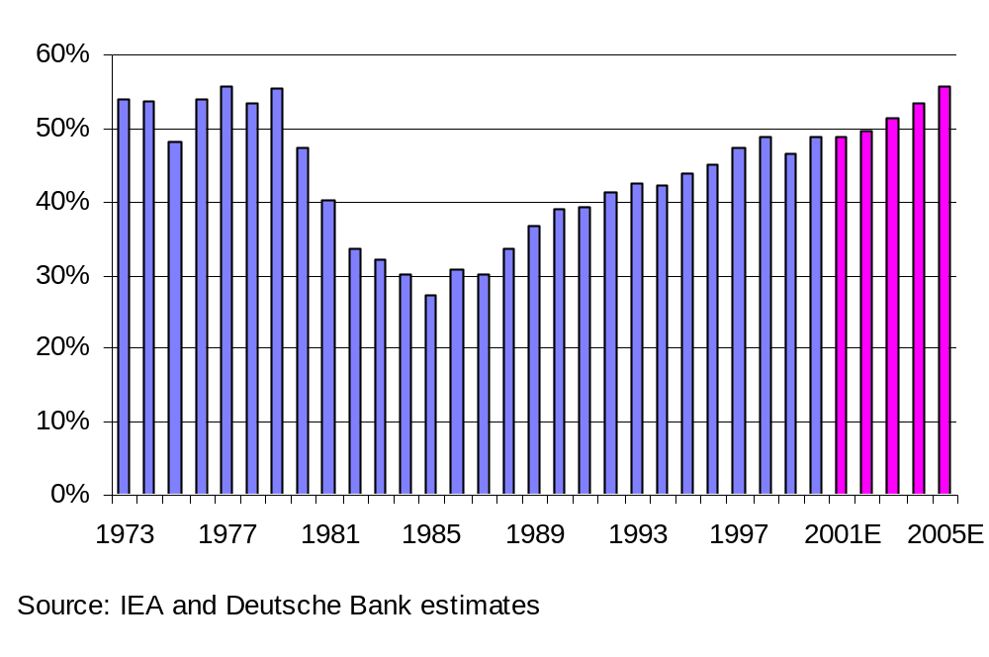
OPEC's Market Share
…after brief setback in 1999-2001, rising again

Slide 16
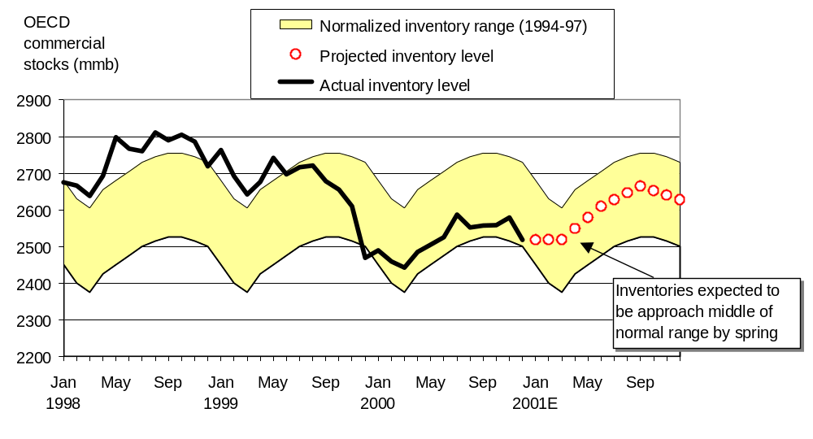
OECD Inventories Remain Key to Next Move in Prices
…base case forecast puts stocks back into the normal range
Source: IEA; Deutsche Banc Alex. Brown estimates

Slide 17
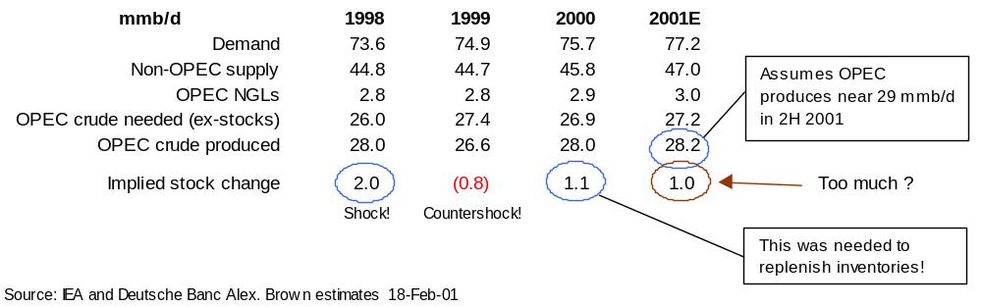
Implied Stock Change for 2001 Suggests Lower Prices
…will OPEC cut fast enough in 2Q 2001?

Slide 18
Natural Gas Sector Snapshot
...fundamentals are better than at any time in recent past and confirm higher level of long-term price strength
    Reserve Additions Have Been Replacing Production …but decline treadmill accelerated as revisions beat discoveries
    Natural Gas Demand Focus Has Been on Electricity …growth in independent power production is huge
    Demand Is Being Impacted by High Prices and Low GDP …utilities and industrial users are under siege
    Tight Supply/Demand Balance Reflected in Storage Position ...has increased upside price volatility but may correct sooner than generally expected as demand subsides

Slide 19
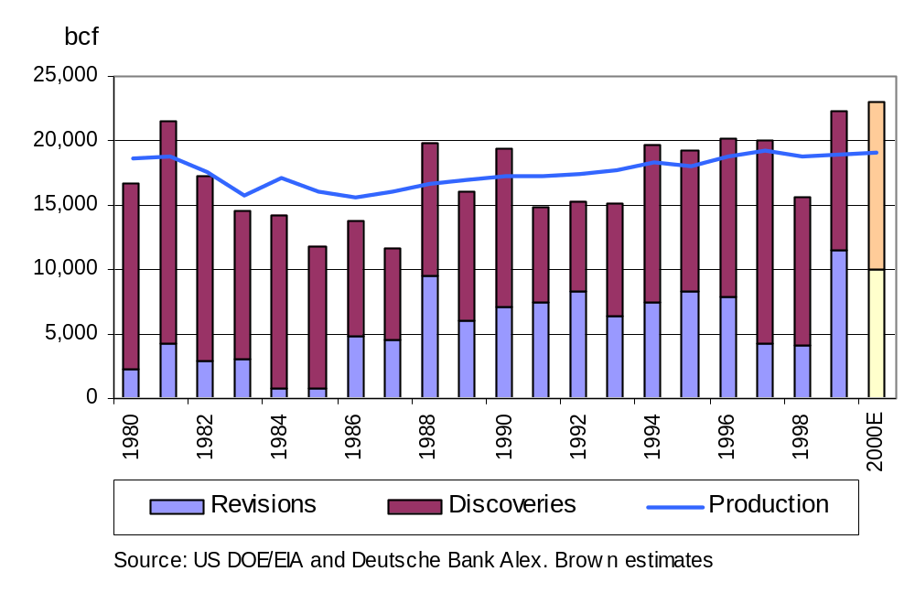
U.S. Gas Production versus Reserve Additions
…total reserve additions replacing production

Slide 20
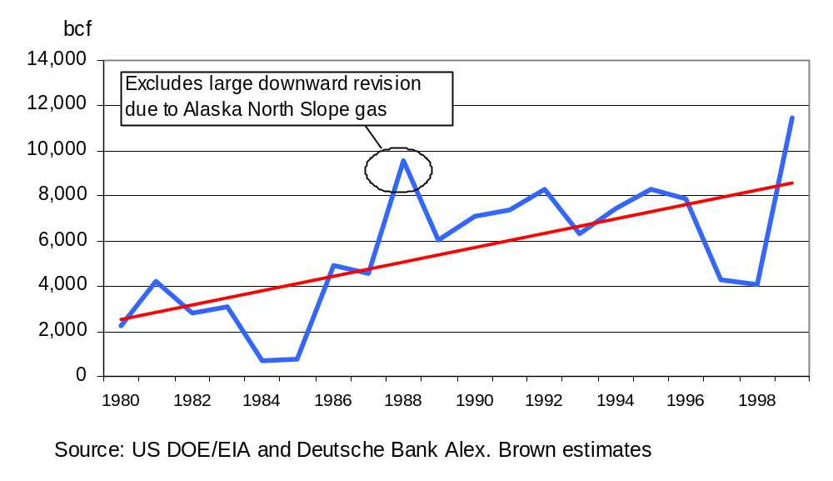
U.S. Gas Reserve Revisions and Adjustments
...upward trend with higher prices and improved technology

Slide 21
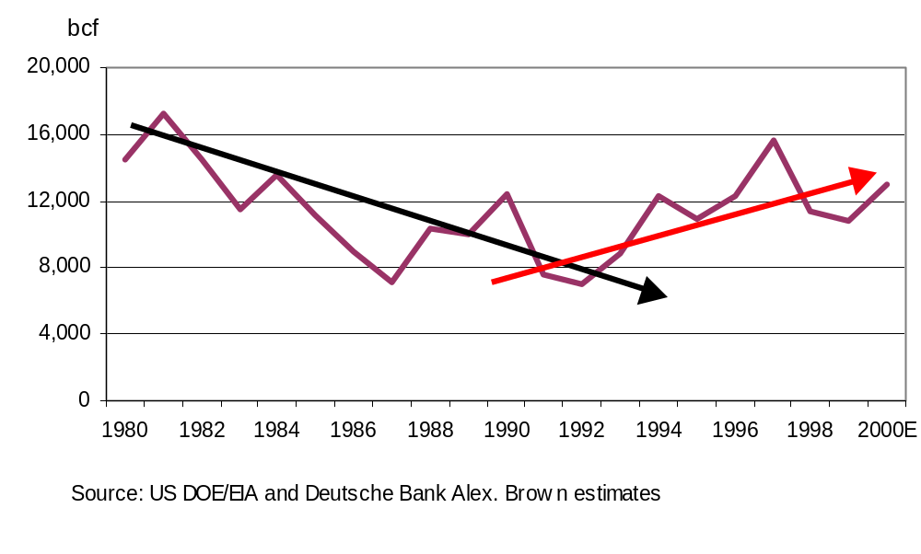
U.S. Gas Reserve Discoveries
…downtrend from 1980 to early 1990s reversed in 1993?

Slide 22
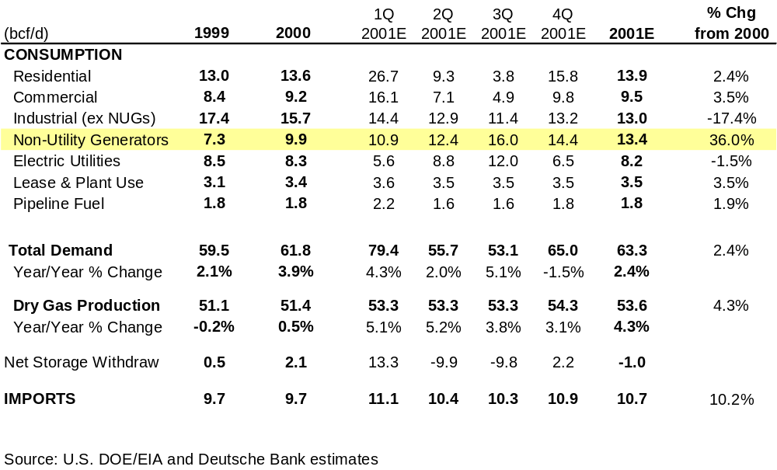
U.S. Gas Demand and Supply
…supply up and demand under pressure in 2001

Slide 23
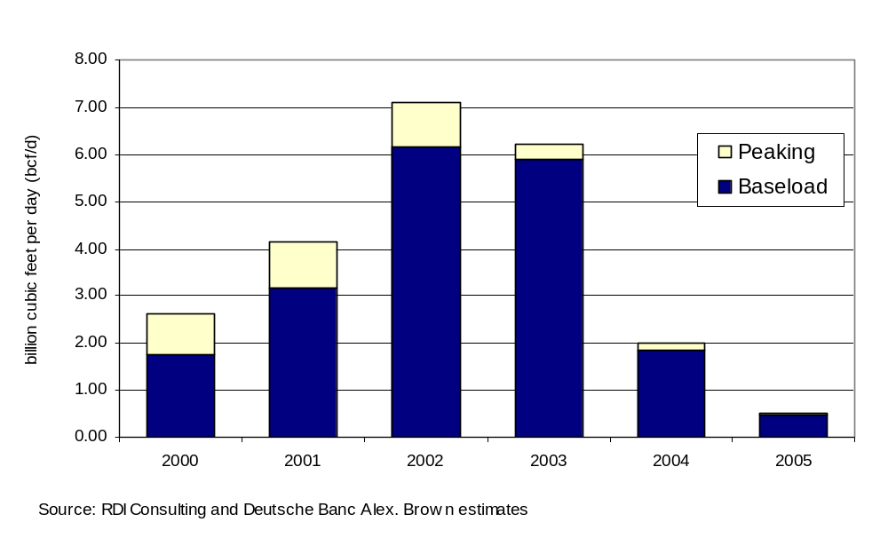
Incremental Natural Gas Demand for Electricity Generation
…some planned additions must get shelved in 2001-2003

Slide 24
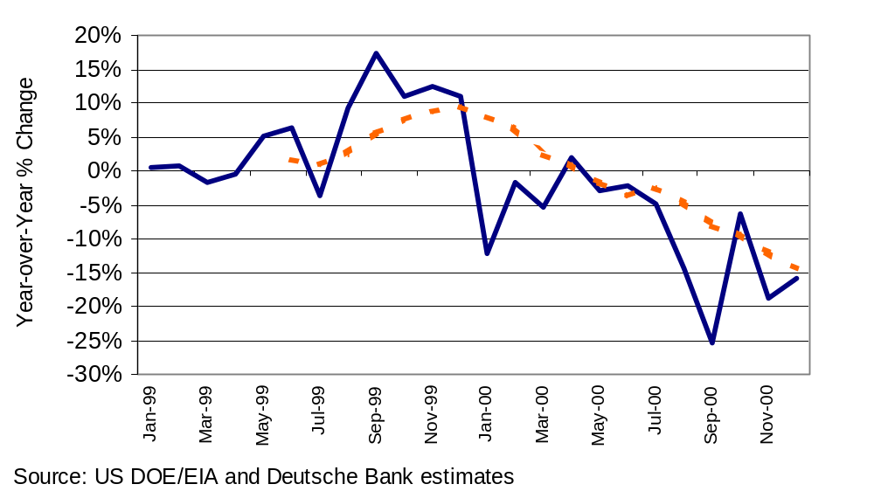
Industrial Natural Gas Use (Ex Non-Utility Generators)
…trend over last the last 12 months is sharply down

Slide 25
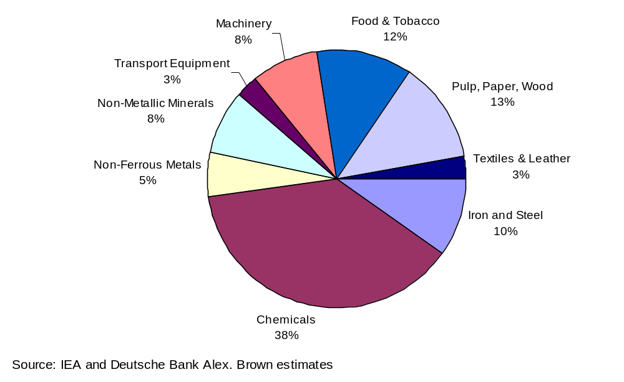
Shares of U.S. Industrial Gas Demand
…chemicals, metals, food and paper

Slide 26
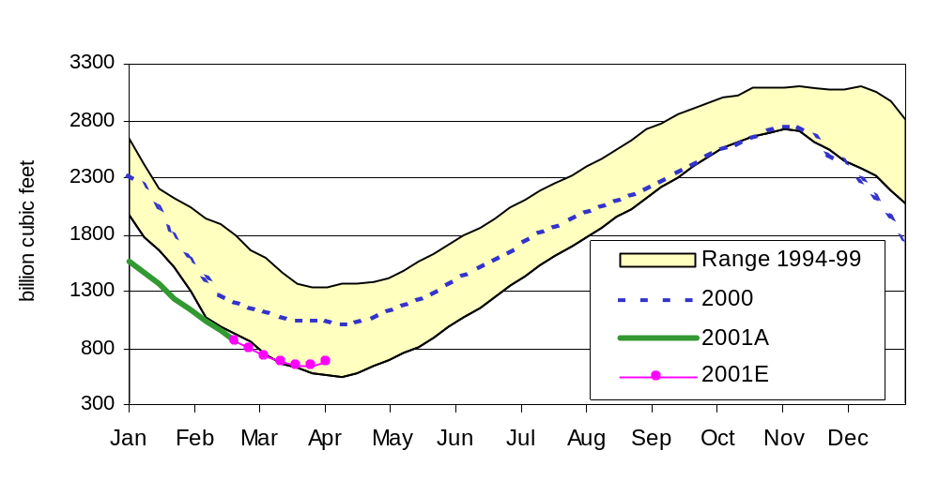
Total U.S. Natural Gas Storage
…below normal but demand drop leads to improved outlook
Source: AGA; Deutsche Bank estimates

Slide 27
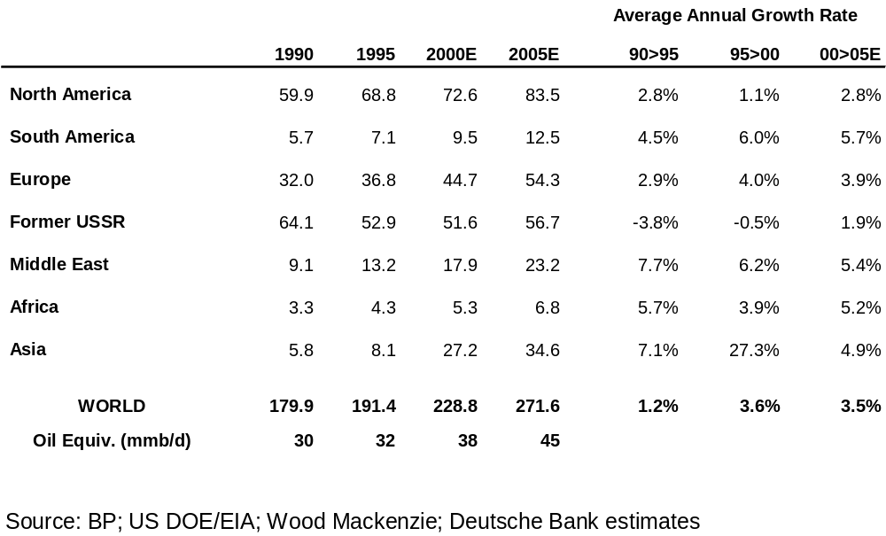
Global Natural Gas Demand Accelerating
…European and Asian consumer fuel of choice

Slide 28

Liquefied Natural Gas (LNG) Trade
...higher prices create strong incentives for growth
From:
  Mid-East
  Malaysia/Brunei
  Indonesia
To:
  Japan
  Korea
125 vessel fleet
Many new entrants
  Spot market developing
About 5% of global supply

Slide 29





Capacity of U.S. LNG Regasification Terminals
Potential
Sendout
Capacity
2001 Storage
Adds (bcf)
Total (bcf)
(bcf/d)
Capacity (bcf)
Timeframe
Everett, MA
0.79
3.6
1.8
5.4
2003
Cove Point, MD
0.75
6.8
2.5
9.3
2002
Elba Island, GA
0.54
4.0
4.0
2002
Lake Charles, LA
0.70
6.3
1.2
7.5
2003/4
Total
2.8
20.7
5.5
26.2
Source:
El Paso Merchant Energy and Wood Mackenzie Consultants

Slide 30

U.S. Energy Policy Set to Shift
…more emphasis on supply and less on environment
Clinton
  emphasize gas use
  bash “big oil”
  no ANWR (Alaska)
  swap US SPR
  tight fuel specifications
  broad trade sanctions support
Bush
  open up federal lands
  de-emphasize Kyoto
  SPR for emergencies only
  eliminate “boutique” fuels
  reduce unilateral sanctions
  shore up US-Arab relations
  Saudis, 3rd Army, 5th Fleet

Slide 31
Always Read the Fine Print
…forecasting is a tough business
Additional information available upon request.
The information and opinions in this report were prepared by Deutsche Bank or one of its affiliates (collectively “Deutsche Bank”). This report is based upon information available to the public. The information herein is believed by Deutsche Bank to be reliable and has been obtained from sources believed to be reliable, but Deutsche Bank makes no representation as to the accuracy of completeness of such information. Deutsche Bank and/or its affiliates worldwide may be market makers or specialists in, act as advisers or lenders to, have positions in and effect transactions in securities of companies mentioned herein and also may provide, may have provided, or may seek to provide investment banking services for those companies. In addition, Deutsche Bank and/or its affiliates or their respective officers, directors and employees hold or may hold long or short positions in the securities, options thereon or other related financial products of companies discussed herein.
Opinions, estimates and projections in this report constitute Deutsche Bank’s judgement and are subject to change without notice. Prices and availability of financial instruments also are subject to change without notice. This report is provided for informational purposes only. It is not to be construed as an offer to buy or sell or a solicitation of an offer to buy or sell any financial instruments or to participate in any particular trading strategy in any jurisdiction in which such an offer or solicitation would violate applicable laws or regulations.
The financial instruments discussed in this report may not be suitable for all investors and investors must make their own investment decisions using their own independent advisors as they believe necessary and based upon their specific financial situations and investment objectives. If a financial instrument is denominated in a currency other than an investor’s currency, a change in exchange rates may adversely affect the price or value of, or the income derived from, the financial instrument, and such investor effectively assumes currency risk. In addition, income from an investment may fluctuate and the price or value of financial instruments described in this report, either directly or indirectly, may rise or fall. Furthermore, past performance is not necessarily indicative of future results.
Unless governing law permits otherwise, all transactions should be executed through the Deutsche Bank entity in the investor’s home jurisdiction. In the U.S. this report is approved and/or distributed by Deutsche Banc Alex. Brown Inc., a member of the NYSE, the NASD and SIPC. In the United Kingdom this report is approved and/or distributed by Deutsche Bank AG, which is regulated by The Securities and Futures Authority (the “SFA”), is not for distribution to private customers (as that term is defined under the rules of the SFA) and no financial instruments referred to herein will be made available to any such private customer. In jurisdictions other than the U.S. and the U.K. this report is distributed by the Deutsche Bank affiliate in the investor’s jurisdiction, and interested parties are advised to contact the Deutsche Bank office with which they currently deal. Additional information relative to securities, other financial products or issuers discussed in this report is available upon request.
No part of this material may be copied or duplicated in any form or by any means, or redistributed, without Deutsche Bank’s prior written consent.
Copyright© 2001 Deutsche Banc Alex. Brown Inc., all rights reserved.

Slide 32
